Slide 1


Motivation for Exploring MyAccessID Adoption at STFC Hartree Centre
Challenges and Requirements for Adoption

Slide 2

Context: Identity in the UK DRI Landscape
Push toward federation (TREs, SDEs, EuroHPC, AIRRFED)
Sudlow Review: federate, not duplicate
Hartree serves academic, industry, government users
Image ©put image credit here

Slide 3
Why MyAccessID Is Relevant Now
Success at AIRR FED (Isambard-AI & Dawn)
60+ research projects utilizing 100K GPU hours on Isambard-AI phase 1.
100+ projects running on Dawn, from institutions across the UK.
AIRR FED expansion plans, supported by DSIT
New remit for AIRR FED to provide HPC and cloud access to UK industry.

Slide 4
Why MyAccessID Is Relevant Now
Introduction of Mary Coombs Cluster at Hartree
High capacity: 157 compute nodes powered by NVIDIA H100 GPUs
Offered as a PaaS solution
Lowering the technology barriers for using the cluster
Possible new model for utilization of spare capacity

Slide 5
Benefits to Hartree
Visibility across UK DRIs
Standardised authentication, Faster onboarding for collaborations.
Reduced operational overhead
Higher assurance via institutional IdPs
New business models: federated workload backfilling

Slide 6
Perspectives at Hartree
Research Software Engineering (RSE) team drives innovation and adoption of cutting-edge technologies
Compliance & Governance ensures policies, assurance levels, risk assessments, and business justification are in place
Operations team prioritises stability, reliability, and proven, supportable technologies
MyAccessID adoption benefits from bringing these perspectives together

Slide 7
Cultural And Operational Barriers
Cultural resistance to change long-established stack.
Preference for classic SSH and SAFE-based access models. Maintaining production service.
Other requirements:
Cybersecurity
Legal and statutory compliance
Hartree, STFC, and UKRI current policies and processes
Ongoing support and governance
Progressive adoption approach

Slide 8
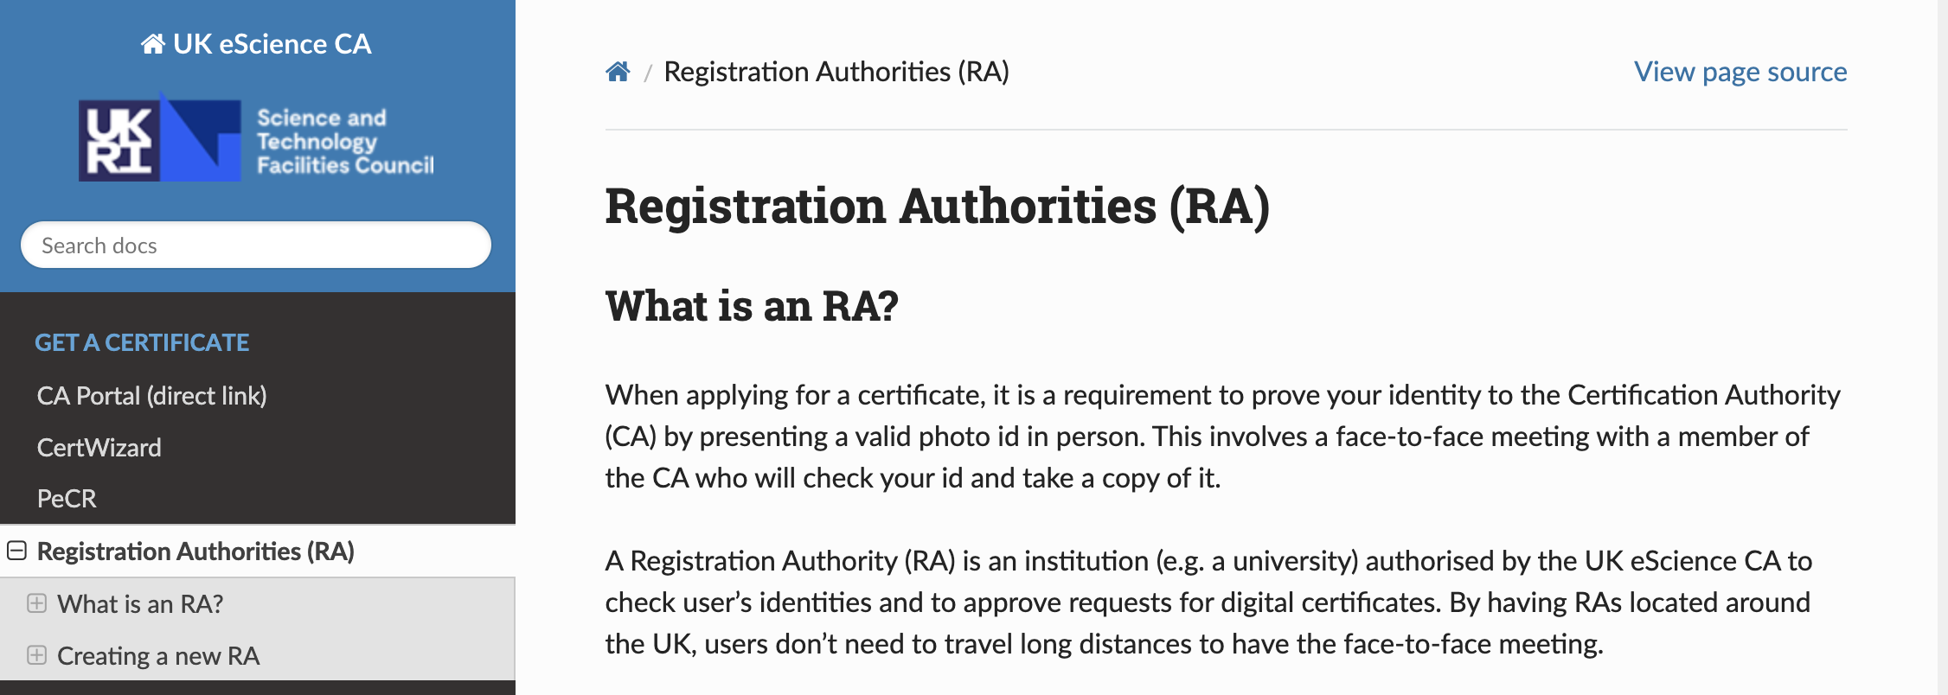
Extending to Government and Industry
Current gap: non-academic identity support
Possible IdP of Last Resort
Centrally managed
Can provide a higher AAL
Email Based Authentication
Convenient but not as secure
By itself only provides AAL1
Registration Authorities

Slide 9
Looking Ahead: A Federated Future
UK DRIs moving toward federation
MyAccessID as the backbone for user identity federation
Project addresses identity gaps
Positions Hartree for future federation

Slide 10
Looking Ahead: A Federated Future
 | Fed Level of Coupling - High to Low
1. | Fully integrated network | Orgs combine infra into a single VRE where data &/OR compute is visible and accessible across all nodes
2. | Fed with implicit trust | Each VRE retains control of their data but allows querying or linked analyses without individual approvals
3. | Fed with central approval hub | VREs delegate to central governance body (SLAs/OLAs)
4. | Fed with peer-to-peer agreements | Each VRE negotiates bilateral or multilateral data & compute access
5. | Isolated but cooperative | VREs share a governance framework
6. | Loose alignment | VREs are part of a directory or community with no shared governance or standards

Slide 11




Thank you
hartree.stfc.ac.uk
@HartreeCentre
STFC Hartree Centre
hartree@stfc.ac.uk

